Slide 1
Networking
iOS

Slide 2
Apple Policy
Apple has and will reject applications that do not check the network status before providing download options to the user
Always verify your network status and alert the user accordingly.
Apple also rejects applications based on “excessive data usage.”

Slide 3
SCNetwork API
Contains functions an application can use to:
  determine whether that application can reach a remote host
  to notify the system of configuration changes.
A remote host is considered reachable when a data packet, sent by an application into the network stack, can leave the local computer.
  Reachability does not guarantee that the data packet will actually be received by the host.

Slide 4
SCNetworkConnection
Contains functions that allow an application
  to control connection-oriented services defined in the system and
  get connection-status information.
These functions allow you to control and get information about existing services only.
To create, change, or remove services, use the SCNetworkConfiguration API.

Slide 5
SCNetworkReachability
Allows an application
  to determine the status of a system's current network configuration
  and the reachability of a target host.
Supports a synchronous and an asynchronous model.
  Synchronous model: get the reachability status by calling the SCNetworkReachabilityGetFlags(_:_:) function.
  Asynchronous model: schedule the SCNetworkReachability object on the run loop of a client object’s thread.
  The client implements a callback function to receive notifications when the reachability status of a given remote host changes.

Slide 6
Network Status
SCNetworkReachabilityGetFlags()
  Is the network reachable
  Is the connection required
  Is user intervention required when establishing a connection.
  Is the network a cell phone network
func SCNetworkReachabilityGetFlags(
_ target: SCNetworkReachability,
_ flags:UnsafeMutablePointer
<SCNetworkReachabilityFlags>) -> Bool
  Target
    The network reference associated with the address or name to be checked for reachability.
  Flags
  A pointer to memory that, on output, is filled with flags that describe the reachability of the specified target

Slide 7
SCNetworkReachabilityFlags
transientConnection
reachable
connectionRequired
    Reachable but a connection must first be established.
connectionOnTraffic ( Same as connectionAutomatic )
    Same as a previous. Any traffic directed to the specified name or address will initiate the connection.
interventionRequired
    Can be reached,. May need to provide a password, an authentication token, etc.
connectionOnDemand
isLoacalAddress
isDirect ( not through a gateway )
isWWAN: ( reached via cellular connection: EDGE, GPRS)
connectionAutomatic:
    Any traffic directed to the specified name or address will initiate the connection. This flag is a synonym for connectionOnTraffic.

Slide 8
// 1 - Create Internet socket addr of zero
  var zeroAddress = sockaddr_in()
  zeroAddress.sin_len = UInt8(MemoryLayout<sockaddr_in>.size)
  zeroAddress.sin_family = sa_family_t(AF_INET)
  // 2- Create target in format needed by SCNetwork
  guard let defaultRouteReachability = withUnsafePointer(to: &zeroAddress, {
  $0.withMemoryRebound(to: sockaddr.self, capacity: 1) {
  SCNetworkReachabilityCreateWithAddress(nil, $0)
  }
  }) else { return false }
  // 3 - Get the flags
  var flags: SCNetworkReachabilityFlags = []
  if !SCNetworkReachabilityGetFlags (defaultRouteReachability, &flags)
  {
  return false
  }
  // 4 - Create output
  let isReachable = flags.contains(.reachable)
  let needsConnection = flags.contains(.connectionRequirede)
  let cellular = flags.contains(.IsWWAN)
  return (isReachable && !needsConnection)

Slide 9
The SCNetworkReachability API allows an application to determine the status of a system's current network configuration and the reachability of a target host.
In addition, reachability can be monitored with notifications that are sent when the status has changed:
  SCNetworkReachabilityScheduleWithRunLoop()
  SCNetworkReachabilitySetCallback()
"Reachability" reflects whether a data packet, sent by an application into the network stack, can leave the local computer.
Reachability does not guarantee that the data packet will actually be received by the host.

Slide 10
Downloads
Synchronous:
  Request data from the Internet, wait until that data is received, and then move on to the next step.
  Ex: Loading an image from a URL:
    [ UIImage imageWithData: [NSData dataWithContentsOfURL: [NSURL URLWithString:urlstring] ] ];
  Use of NSURLConnection class : ( deprecated)
    provides a more general download approach (Synch and Asynch).
  Since this request is blocking, it is usually performed in a second thread.

Slide 11
Asynchronous Downloads
  Download data in the background.
  No blocking while waiting for a download to finish
Follow these steps:
1- // Create the request
  request = [[NSMutableURLRequest alloc] initWithURL:[NSURL URLWithString:@"http://stream.twitter.com/1/statuses/filter.xml"]];
  [request setHTTPMethod:@"POST"];
2- // Connect to service
[request setHTTPBody:[httpBody dataUsingEncoding:NSUTF8StringEncoding]]; connection = [[NSURLConnection alloc] initWithRequest:request
delegate:self
startImmediately:YES];
[request release];

Slide 12
3- //Receiving Data
  Now the stream will start sending data
  The stream will send NSData into this NSURLConnection delegate method:
  (void)connection:(NSURLConnection *)connection didReceiveData:(NSData *)data {
  }
4- // Answering Authentication
  The NSURLConnection will connect to the requested stream and if the application asks for a username and password for the request, the NSURLConnection’s delegate should implement the following method to answer the appRequest:
  - (void)connection:(NSURLConnection *)connection didReceiveAuthenticationChallenge:(NSURLAuthenticationChallenge *)challenge {
  NSURLCredential *cred = [[NSURLCredential alloc] initWithUser:@"USERNAME" password:@"PASSWORD" persistence:NSURLCredentialPersistencePermanent];
  [[challenge sender] useCredential:cred forAuthenticationChallenge:challenge];
  NSLog(@"Received Challenge");
  [cred release];
  }

Slide 13
5-// May need to parse data
-(void)parseXMLString:(NSString*)xmlString {
CXMLDocument *document = [[CXMLDocument alloc] initWithXMLString:xmlString
options:0 error:nil ];
…
}
Retrieve element :
[[[[document rootElement] elementsForName:@"text"] objectAtIndex:0] stringValue]];

Slide 14
NSURLConnection Methods
- (void)connection:(NSURLConnection *)connection didReceiveResponse:(NSURLResponse *)response {
  [_data release];
  _data = [[NSMutableData alloc] init];
  NSHTTPURLResponse * httpResponse = (NSHTTPURLResponse *)response;
  _statusCode = [httpResponse statusCode];
  }
- (void)connection:(NSURLConnection *)connection didReceiveData:(NSData *)data {
  [_data appendData:data];
}
– (void)connectionDidFinishLoading:(NSURLConnection *)connection {
    [self finish];
}
- (void)connection:(NSURLConnection *)connection didFailWithError:(NSError *)error {
  _error = [error copy];
  [self finish];
  }

Slide 15
Networking with URLSession

Slide 16
Networking with URLSession
URLSession to replace URLConnection
    modern, easier to use, and built with mobile in mind.
    URLSession and URLConnection both provide an API for interacting with various protocols, such as HTTP and HTTPS
    The session object, an instance of the URLSession class, is what manages this interaction.

Slide 17
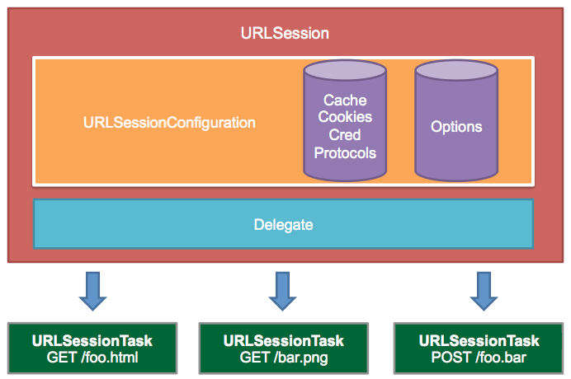
Copyright: raywenderlich.com

Slide 18
Retrieving the Contents of a URL without Delegates
URLSession class calling:
  dataTask(with url: URL) -> URLSessionDataTask
  dataTask(with request: URLRequest) -> URLSessionDataTask)
  dataTask(with url: URL, completionHandler: @escaping (Data?, URLResponse?, Error?) -> Void) -> URLSessionDataTask
  dataTask(with request: URLRequest, completionHandler: @escaping (Data?, URLResponse?, Error?) -> Void) -> URLSessionDataTask
Provide:
    an NSURL object
    or a filled-out NSURLRequest object that provides the URL, body data, and any other information
    A completion handler block that runs whenever the transfer finishes or fails.
Return:
    an NSData object and an NSURLResponse (success)
    an NSError object ( Failure)

Slide 19
Retrieving the Contents of a URL with Delegates
use the URLSession class with a custom delegate
Provide a reusable configuration object that encapsulates many common configuration options.
A URLSession object manages multiple tasks, each of which represents a single URL request and any follow-on requests.
The connection or session is automatically scheduled in the current run loop in the default run loop mode once URLSession is initialized
The delegate receives notifications throughout the connection process to the URLSession:dataTask:didReceiveData:
It is the delegate’s responsibility to keep track of the data it has already received
When the URLSession:task:didCompleteWithError: or connectionDidFinishLoading: method is called, the delegate has received the entirety of the URL’s contents.

Slide 20
Tasks
  The basic unit of work when working with URLSession - instance of URLSessionTask
  data tasks ( URLSessionDataTask )
    used for requesting data from a server, such as JSON data
    The data is only stored in memory
  upload tasks ( URLSessionUploadTask )
    used to upload data to a remote destination.
    The URLSessionUploadTask is a subclass of URLSessionDataTask and behaves in a similar fashion.
    Can be used in a session created with a background session configuration.

Slide 21
  download tasks
    instances of URLSessionDownloadTask, inherit directly from URLSessionTask.
    writes its response directly to a temporary file
    Can be canceled and resumed at a later point
  URLSessionStreamTask
    establish a TCP/IP connection from a host name and port or a net service object,
  URLSession API returns data by invoking a completion handler or through the session's delegate
  URLSessionConfiguration class handles the configuration of the session object
  URLSessionTask class and its three concrete subclasses are the workers and are always used in conjunction with a session as it is the session that creates the task objects.

Slide 22
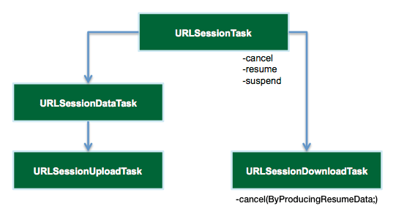
Copyright: raywenderlich.com

Slide 23
URLSessionConfiguration
  A dictionary of properties that defines how the session is tied to behave.
  A session has one session configuration object
    dictates cookie, security, and cache policies, the maximum number of connections to a host, resource and network timeouts etc…
  Once a session is created and configured by a URLSessionConfiguration instance, the session's configuration cannot be modified.

Slide 24
The behavior of a session is determined in part by which method you call when creating its configuration object:
The singleton shared session
  Has no configuration object
  Used for basic requests.
  Not as customizable as other created sessions
  serves as a good starting point when there are very limited requirements.
  Can be accessed by calling the Session class method.

Slide 25
Default sessions
  behave much like the shared session (unless it is customized further),
  Allows obtaining data incrementally using a delegate.
  can create a default session configuration by calling the default method on the URLSessionConfiguration class.
Then call :
  init(configuration: URLSessionConfiguration)
  Or
  init(configuration: URLSessionConfiguration, delegate: URLSessionDelegate?, delegateQueue queue: OperationQueue?)

Slide 26
Ephemeral sessions
  similar to default sessions
  Do not write caches, cookies, or credentials to disk.
  Can be created by calling the ephemeral method on the NSURLSessionConfiguration class then init().
Background sessions
  perform uploads and downloads of content in the background while the app is not running.
  Can be created by calling the background(withIdentifier:) method on the NSURLSessionConfiguration class then init().

Slide 27
Session Creation
init(configuration: URLSessionConfiguration)
init(configuration: URLSessionConfiguration, delegate: URLSessionDelegate?, delegateQueue: OperationQueue?)
  delegate: URLSessionDelegate?
    A session delegate object that handles requests for authentication and other session-related events.
  delegateQueue: OperationQueue ?
    An operation queue for scheduling the delegate calls and completion handlers.
    The queue need not be a serial queue.
    If nil, the session creates a serial operation queue for performing all delegate method calls and completion handler calls.
shared
The session object keeps a strong reference to its delegate and queue until the app exits or the session object is deallocated. If the session is not invalidated, the app leaks memory until it exits.

Slide 28
// Create Session Configuration
var sessionConfiguration : URLSessionConfiguration = NSURLSessionConfiguration.default
// Configure Session Configuration
sessionConfiguration.allowsCellularAccess = true
sessionConfiguration.httpAdditionalHeaders = ["Accept" : "application/json” ]
// Create Session
let session: URLSession = URLSession(configuration: sessionConfiguration)
// Send Request
let url: URL = URL( string:”https://itunes.apple.com/search?term=apple&media=software”)
session.dataTask(with:url,completionHandler: (Data *data, URLResponse *response, Error *error) {
print( \(JSONSerialization.jsonObject(with:data options:[]));
}.resume()

Slide 29
Canceling and Resuming Downloads
A download task can be suspended and resumed at a later time
If a task is cancelled, it cannot be resumed later
If cancelled using cancelByProducingResumeData: it can be resumed using : downloadTaskWithResumeData: or downloadTaskWithResumeData:completionHandler: on a session object.
NSData is saved when task is cancelled to save the download state and re-used when resuming the download.

Slide 30
Adding Data tasks to a session
dataTask( with: URL)
dataTask( with: URL, completionHandler: (Data?,URLResponse?, Errorr?) -> Void)
dataTask( with: URLRequest)
dataTask(with:URLRequest : completionHandler: (Data?,URLResponse?, Errorr?) -> Void)
Similarly for : downloadTask , uploadTask and streamTask.
After you create the task, you must start it by calling its resume method

Slide 31
Managing a Session
finishTasksAndInvalidate()
      returns immediately without waiting for tasks to finish.
      Once a session is invalidated, new tasks cannot be created in the session
      existing tasks continue until completion.
      After invalidation, session objects cannot be reused.
-flush(completionHandler: () -> Void)
      Flushes cookies and credentials to disk
      clears transient caches
      ensures that future requests occur on a new TCP connection.
getTasksWithCompletionHandler(([URLSessionDataTask], [URLSessionUploadTask], [URLSessionDownloadTask]) -> Void)
      Asynchronously calls a completion callback with all data, upload, and download tasks in a session.
invalidateAndCancel()
        Cancels all outstanding tasks and then invalidates the session.
reset(completionHandler: () -> Void)
        Empties all cookies, caches and credential stores,
        removes disk files,
        flushes in-progress downloads to disk
        ensures that future requests occur on a new socket.

Slide 32
Provided Protocols
URLSessionDelegate
      Defines delegate methods to handle session-level events
URLSessionTaskDelegate
      Defines delegate methods to handle task-level events common to all task types
URLSessionDataDelegate
      Defines delegate methods to handle task-level events specific to data and upload tasks
URLSessionDownloadDelegate
      Defines delegate methods to handle task-level events specific to download tasks
URLSessionStreamDelegate
      Defines delegate methods to handle task-level events specific to stream tasks

Slide 33
Other used classes
NSURL
  An object that contains a URL.
NSURLRequest
  Encapsulates metadata related to a URL request, including the URL, request method, and so on.
NSURLResponse
  Encapsulates metadata related to a server’s response to a request, such as the content MIME type and length.
  NSHTTPURLResponse
    Adds additional metadata specific to HTTP requests, such as response headers.
NSCachedURLResponse
  Encapsulates an NSURLResponse object, along with the actual body data of the server’s response, for caching purposes.

Slide 34
Delegate Methods
func urlSession(URLSession, task: URLSessionTask, didReceive: URLAuthenticationChallenge, completionHandler: (URLSession.AuthChallengeDisposition, URLCredential?) -> Void)
func urlSession(URLSession, task: URLSessionTask, needNewBodyStream: (InputStream?) -> Void)
func urlSession(URLSession, task: URLSessionTask, willPerformHTTPRedirection: HTTPURLResponse, newRequest: URLRequest, completionHandler: (URLRequest?) -> Void)
func urlSession(URLSession, task: URLSessionTask, didFinishCollecting: URLSessionTaskMetrics)
func urlSession(URLSession, task: URLSessionTask, didCompleteWithError: Error?)
func urlSession(URLSession, taskIsWaitingForConnectivity: URLSessionTask)
func urlSession(URLSession, task: URLSessionTask, willBeginDelayedRequest: URLRequest, completionHandler: (URLSession.DelayedRequestDisposition, URLRequest?) -> Void)
func urlSession(_:task:didSendBodyData:totalBytesSent:totalBytesExpectedToSend:)

Slide 35
Using Keychains
A keychain lets you store user credentials securely.
“Secure” password text fields that save their data to regular files are not particularly secure.
Although the text is obscured onscreen, files, including preferences files, use clear text when written to disk.
With the keychain, Apple provides a built-in highly secure password service that takes care of the work for you.
keychain uses the Security framework. This framework is available exclusively for the device only.
Keychain data persists even after un-installing the corresponding application.
The same keychain can be shared across multiple applications. Needs to be set in Xcode (page 576)

Slide 36
Use keyChain through KeychainItemWrapper class as follows:
1-// create an instance and initialize it with an identifier and access group
self. wrapper = [[ KeychainItemWrapper alloc]
initWithIdentifier:@“name"
accessGroup: nil];
[ self.wrapper release];
2 -// write items into the keychain
[self.wrapper setObject: uname forKey: (id)kSecAttrAccount];
[self.wrapper setObject: pword forKey: (id)kSecValueData] ;
3- // Retrieve data
uname = [self. wrapper objectForKey:( id) kSecAttrAccount] ;
pword = [self. wrapper objectForKey:( id) kSecValueData];

Slide 37
eXtensible Markup Language
XML

Slide 38
What is XML
XML stands for EXtensible Markup Language
XML is a markup language much like HTML
XML was designed to carry data, not to display data
XML tags are not predefined. You must define your own tags
XML is designed to be self-descriptive
XML is a W3C Recommendation
XML is a software- and hardware-independent tool for carrying information.

Slide 39
The Difference Between XML and HTML
XML is not a replacement for HTML.
XML and HTML were designed with different goals:
XML was designed to transport and store data, with focus on what data is
HTML was designed to display data, with focus on how data looks
HTML is about displaying information, while XML is about carrying information.
The tags used in HTML are predefined. HTML documents can only use tags defined in the HTML standard (like <p>, <h1>, etc.).
XML allows the author to define his/her own tags and his/her own document structure.

Slide 40
XML Example
<note>
<to>Tove</to>
<from>Jani</from>
<heading>Reminder</heading>
<body>Don't forget me this weekend!</body>
</note>

Slide 41
XML is Everywhere
A lot of new Internet languages are created with XML.
Here are some examples:
XHTML
WSDL for describing available web services
WAP and WML as markup languages for handheld devices
RSS languages for news feeds
RDF and OWL for describing resources and ontology
SMIL for describing multimedia for the web

Slide 42
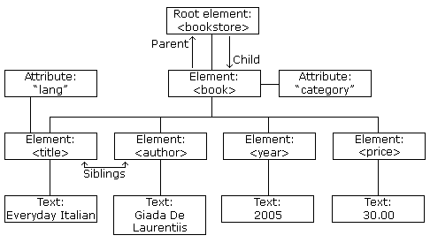
XML Documents Form a Tree Structure

Slide 43
The image above represents one book in the XML below:
<bookstore>
<book category="COOKING">
<title lang="en">Everyday Italian</title>
<author>Giada De Laurentiis</author>
<year>2005</year>
<price>30.00</price>
</book>
<book category="CHILDREN">
<title lang="en">Harry Potter</title>
<author>J K. Rowling</author>
<year>2005</year>
<price>29.99</price>
</book>
<book category="WEB">
<title lang="en">Learning XML</title>
<author>Erik T. Ray</author>
<year>2003</year>
<price>39.95</price>
</book>
</bookstore>
---------------------------------------------------------------------------------------------------------------------------------------
<root>
<child>
<subchild>.....</subchild>
</child>
</root>

Slide 44
More about XML
In HTML, elements do not have to have a closing tag:
    <p>This is a paragraph
    <p>This is another paragraph
In XML, it is illegal to omit the closing tag. All elements must have a closing tag:
    <p>This is a paragraph</p>
    <p>This is another paragraph</p>
XML tags are case sensitive. The tag <Letter> is different from the tag <letter>.
Opening and closing tags must be written with the same case:
    <Message>This is incorrect</message>
    <message>This is correct</message>
In XML, all elements must be properly nested within each other:
    <b><i>This text is bold and italic</i></b>
XML documents must contain one element that is the parent of all other elements. This element is called the root element.
    <root>
    <child>
    <subchild>.....</subchild>
    </child>
    </root>
In XML, the attribute values must always be quoted.
    <note date="12/11/2007"

Slide 45
There are 5 predefined entity references in XML:
    &lt; < less than
    &gt; > greater than
    &amp; & ampersand
    &apos; ' apostrophe
    &quot; " quotation mark
The syntax for writing comments in XML is similar to that of HTML.
    <!-- This is a comment -->
HTML truncates multiple white-space characters to one single white-space
XML stores a new line as LF.

Slide 46
XML Elements
An XML element is everything from (including) the element's start tag to (including) the element's end tag.
An element can contain other elements, simple text or a mixture of both. Elements can also have attributes.
<bookstore>
<book category="CHILDREN">
<title>Harry Potter</title>
<author>J K. Rowling</author>
<year>2005</year>
<price>29.99</price>
</book>
<book category="WEB">
<title>Learning XML</title>
<author>Erik T. Ray</author>
<year>2003</year>
<price>39.95</price>
</book>
XML elements can be extended to carry more information.
  XML elements must follow these naming rules:
  Names can contain letters, numbers, and other characters
  Names cannot start with a number or punctuation character
  Names cannot start with the letters xml (or XML, or Xml, etc)
  Names cannot contain spaces

Slide 47
XML Attributes
XML elements can have attributes, just like HTML.
Attributes provide additional information about an element.
Attributes often provide information that is not a part of the data. In the example below, the file type is irrelevant to the data, but can be important to the software that wants to manipulate the element:
    <file type="gif">computer.gif</file>
Attribute values must always be quoted. Either single or double quotes can be used. For a person's sex, the person element can be written like this:
    <person sex="female"> or like this:
    <person sex='female'>
Some of the problems with using attributes are:
    attributes cannot contain multiple values (elements can)
    attributes cannot contain tree structures (elements can)
    attributes are not easily expandable (for future changes)

Slide 48
Valid/Well Formed XML
A "Well Formed" XML document has correct XML syntax.
The syntax rules :
    XML documents must have a root element
    XML elements must have a closing tag
    XML tags are case sensitive
    XML elements must be properly nested
    XML attribute values must be quoted
A "Valid" XML document is a "Well Formed" XML document, which also conforms to the rules of a Document Type Definition (DTD):
    <?xml version="1.0" encoding="ISO-8859-1"?>
    <!DOCTYPE note SYSTEM "Note.dtd">
    <note>
    <to>Tove</to>
    <from>Jani</from>
    <heading>Reminder</heading>
    <body>Don't forget me this weekend!</body>
    </note>

Slide 49
XML DTD/XML Schema
XML DTD
The purpose of a DTD is to define the structure of an XML document. It defines the structure with a list of legal elements:
  <!DOCTYPE note
  [
  <!ELEMENT note (to,from,heading,body)>
  <!ELEMENT to (#PCDATA)>
  <!ELEMENT from (#PCDATA)>
  <!ELEMENT heading (#PCDATA)>
  <!ELEMENT body (#PCDATA)>
  ]>
W3C supports an XML-based alternative to DTD, called XML Schema:
  <xs:element name="note">
  <xs:complexType>
  <xs:sequence>
  <xs:element name="to" type="xs:string"/>
  <xs:element name="from" type="xs:string"/>
  <xs:element name="heading" type="xs:string"/>
  <xs:element name="body" type="xs:string"/>
  </xs:sequence>
  </xs:complexType>
  </xs:element>

Slide 50
XML DOM
The XML DOM (Document Object Model) defines a standard way for accessing and manipulating XML documents.
The XML DOM views an XML document as a tree-structure.
All elements can be accessed through the DOM tree. Their content (text and attributes) can be modified or deleted, and new elements can be created. The elements, their text, and their attributes are all known as nodes.

Slide 51
XML Namespaces
In XML, element names are defined by the developer. This often results in a conflict when trying to mix XML documents from different XML applications.
Name conflicts in XML can easily be avoided using a name prefix.
This XML carries information about an HTML table, and a piece of furniture:
    <h:table>
    <h:tr>
    <h:td>Apples</h:td>
    <h:td>Bananas</h:td>
    </h:tr>
    </h:table>
    <f:table>
    <f:name>African Coffee Table</f:name>
    <f:width>80</f:width>
    <f:length>120</f:length>
    </f:table>
When using prefixes in XML, a so-called namespace for the prefix must be defined.
The namespace is defined by the xmlns attribute in the start tag of an element.
The namespace declaration has the following syntax. xmlns:prefix="URI".
    <root>
    <h:table xmlns:h="http://www.w3.org/TR/html4/">
    <h:tr>
    <h:td>Apples</h:td>
    <h:td>Bananas</h:td>
    </h:tr>
    </h:table>
    <f:table xmlns:f="http://www.w3schools.com/furniture">
    <f:name>African Coffee Table</f:name>
    <f:width>80</f:width>
    <f:length>120</f:length>
    </f:table>
    </root>

Slide 52
XML CDATA
All text in an XML document will be parsed by the parser. But text inside a CDATA section will be ignored by the parser.
PCDATA - Parsed Character Data
XML parsers normally parse all the text in an XML document.
When an XML element is parsed, the text between the XML tags is also parsed:
  <message>This text is also parsed</message>
The parser does this because XML elements can contain other elements, as in this example, where the <name> element contains two other elements (first and last):
  <name><first>Bill</first><last>Gates</last></name> and the parser will break it up into sub-elements like this:
<name>
<first>Bill</first>
<last>Gates</last>
</name> Parsed Character Data (PCDATA) is a term used about text data that will be parsed by the XML parser.
CDATA - (Unparsed) Character Data
The term CDATA is used about text data that should not be parsed by the XML parser.
  Characters like "<" and "&" are illegal in XML elements.
  "<" will generate an error because the parser interprets it as the start of a new element.
  "&" will generate an error because the parser interprets it as the start of an character entity.
Some text, like JavaScript code, contains a lot of "<" or "&" characters. To avoid errors script code can be defined as CDATA.
Everything inside a CDATA section is ignored by the parser.
A CDATA section starts with "<![CDATA[" and ends with "]]>":
A CDATA section cannot contain the string "]]>". Nested CDATA sections are not allowed.
The "]]>" that marks the end of the CDATA section cannot contain spaces or line breaks.

Slide 53
XML Parser Types
A model parser
  reads an entire document and creates a representation of the document in memory.
  They use significantly more memory than other types of parsers.
  (This is how the popular DOM API operates.)
A push parser /event-driven
  reads through an entire document. As it encounters various parts of the document, it notifies a listener object.
  (This is how the popular SAX API operates.)
A pull parser
  reads a little bit of a document at once.
  The application drives the parser through the document by repeatedly requesting the next piece.

Slide 54
Using XML iPhone
iPhone support XML parsing using the NSXMLParser class
The NSXMLParser class adopts the event-driven style of parsing (i.e., using the typical logic of a SAXparser).
But instead of using callbacks, an NSXMLParser object sends messages to its delegate;
it sends a different message for each type of parsing event.
As the parser sequentially encounters each item in an XML or DTD file—element, attribute, declaration, entity reference, and so on—it reports it to its delegate (if the delegate implements the associated method), along with any surrounding context.
It does nothing with the item except report it.

Slide 55
NSXMLParser/XMLParser
The NSXMLParser class provided in the iPhone SDK scans through XML(i.e., using the typical logic of a SAXparser).
Not convenient in all scenarios such as those that relie on error checking, status information, and back-and-forth handshaking.
NSXMLParser does not offer any help with validation (i.e. if XML conforms to the structuring rules as specified in a DTD or other schema).
Tree data structures offer a better way to represent XML data.
They allow you to create search paths through the data, so you can find just the data you’re looking for.
You can retrieve all “entries,” search for a success value, and so forth.
Trees convert text-based XML back into a multidimensional structure.
Page 577 give an example of an NSXMLParser-based helper class that returns more standard tree-based data.
Also see: http://developer.apple.com/library/ios/#documentation/Cocoa/Conceptual/XMLParsing/Articles/ConstructingTrees.html for building an XML tree

Slide 56
XML events example
  <?xml version= "1.0" encoding="UTF8">
  <article author="John Doe">
  <para>This is a very short article.</para>
  </article>
The parser would report the following series of events to its delegate:
Started parsing document
Found start tag for element article
Found attribute author of element article, value “John Doe”
Found start tag for element para
Found characters This is a very short article.
Found end tag for element para
Found end tag for element article
Ended parsing document

Slide 57
Parsing begins with the delegate receiving parserDidStartDocument:
  Here you can allocate and set up resources needed for the parsing operation
and end with the delegate receiving parserDidEndDocument:
  Here you can release resources and properly dispose of any result
If the parser encounters an error, it stops parsing and invokes the delegation method parser(XMLParser,parseErrorOccurred:Error)
  Here interpret the error and inform the user.
One technique to better handle the memory management issues is for the delegate to create a local autorelease pool at the beginning of each implemented delegation method and release the autorelease pool just before returning.
XMLParser manages the memory for each object it creates and sends to the delegate.

Slide 58
XMLParsder sends at least three separate message to its delegate, in the following order:
  func parser(XMLParser, didStartElement: String, namespaceURI: String?, qualifiedName: String?, attributes: [String : String] = [:]):
  func parser(XMLParser, foundCharacters: String):
  func parser(XMLParser, didEndElement: String, namespaceURI: String?, qualifiedName: String?)
  The parser might send the parser:foundCharacters: message multiple times for one element;
parser(XMLParser, foundIgnorableWhitespace: String): is sent instead of parser:foundCharacters for characters such as (space, new line, tab, and similar characters)
var delegate: XMLParserDelegate?
  A delegate object that receives messages about the parsing process.

Slide 59
XMLParser
init?(contentsOf: URL):
  Initializes the receiver with the XML content referenced by the given URL.
init(data: Data):
  Initializes the receiver with the XML contents encapsulated in a given data object.
init(stream: InputStream)
  Initializes a parser with the XML contents from the specified stream and parses it
lineNumber
  Returns the line number of the XML document being processed by the receiver.
func parse()
  Starts the event-driven parsing operation.
abortParsing()
  Stops the parser object.
var parserError: Error?
  An NSError object from which you can obtain information about a parsing error.

Slide 60
Web Services
SOAP: Simple Object Access Protocol
  It is a simple XML-based protocol to let applications exchange information over HTTP
  It is a format for sending messages via Internet
  It is platform independent and language independent
  Based on XML, simple and extensible
  Can get around firewalls, not blocked by firewalls and proxy servers as an RPC traffic would be
  W3C recommendation

Slide 61
SOAP Building Blocks
A SOAP message is an ordinary XML document containing the following elements:
    An Envelope element that identifies the XML document as a SOAP message
    A Header element that contains header information
    A Body element that contains call and response information
    A Fault element containing errors and status information
All the elements above are declared in the default namespace for the SOAP envelope:
http://www.w3.org/2001/12/soap-envelope
and the default namespace for SOAP encoding and data types is: http://www.w3.org/2001/12/soap-encoding

Slide 62
Skeleton SOAP Message
<?xml version="1.0"?>
<soap:Envelope
xmlns:soap="http://www.w3.org/2001/12/soap-envelope"
soap:encodingStyle="http://www.w3.org/2001/12/soap-encoding">
<soap:Header>
...
</soap:Header>
<soap:Body>
...
<soap:Fault>
...
</soap:Fault>
</soap:Body>
</soap:Envelope>

Slide 63
A SOAP Example
In the example below
  a GetStockPrice request is sent to a server.
  The request has a StockName parameter, and a Price parameter that will be returned in the response.
  The namespace for the function is defined in "http://www.example.org/stock".

Slide 64
A SOAP request
POST /InStock HTTP/1.1
Host: www.example.org
Content-Type: application/soap+xml; charset=utf-8
Content-Length: nnn
<?xml version="1.0"?>
<soap:Envelope
xmlns:soap="http://www.w3.org/2001/12/soap-envelope"
soap:encodingStyle="http://www.w3.org/2001/12/soap-encoding">
<soap:Body xmlns:m="http://www.example.org/stock">
<m:GetStockPrice>
<m:StockName>IBM</m:StockName>
</m:GetStockPrice>
</soap:Body>
</soap:Envelope>

Slide 65
The SOAP response
HTTP/1.1 200 OK
Content-Type: application/soap+xml; charset=utf-8
Content-Length: nnn
<?xml version="1.0"?>
<soap:Envelope
xmlns:soap="http://www.w3.org/2001/12/soap-envelope"
soap:encodingStyle="http://www.w3.org/2001/12/soap-encoding">
<soap:Body xmlns:m="http://www.example.org/stock">
<m:GetStockPriceResponse>
<m:Price>34.5</m:Price>
</m:GetStockPriceResponse>
</soap:Body>
</soap:Envelope>

Slide 66
Soap Example
http://w3schools.com/webservices/tempconvert.asmx?op=CelsiusToFahrenheit
NSString *soapMessage = @"<?xml version="1.0" encoding="utf-8"?>n"
"<soap:Envelope xmlns:xsi="http://www.w3.org/2001/XMLSchema-instance" xmlns:xsd="http://www.w3.org/2001/XMLSchema" xmlns:soap="http://schemas.xmlsoap.org/soap/envelope/">n"
"<soap:Body>n"
"<CelsiusToFahrenheit xmlns="http://tempuri.org/">n"
"<Celsius>50</Celsius>n"
"</CelsiusToFahrenheit>n"
"</soap:Body>n"
"</soap:Envelope>n";

Slide 67
NSURL *url = [NSURL URLWithString:@"http://w3schools.com/webservices/tempconvert.asmx"]; NSMutableURLRequest *theRequest = [NSMutableURLRequest requestWithURL:url]; NSString *msgLength = [NSString stringWithFormat:@"%d", [soapMessage length]]; [theRequest addValue: @"text/xml; charset=utf-8" forHTTPHeaderField:@"Content-Type"]; [theRequest addValue: @http://tempuri.org/CelsiusToFahrenheit” forHTTPHeaderField:@"SOAPAction"]; [theRequest addValue: msgLength forHTTPHeaderField:@"Content-Length"]; [theRequest setHTTPMethod:@"POST"]; [theRequest setHTTPBody: [soapMessage dataUsingEncoding: NSUTF8StringEncoding]]; NSURLConnection *theConnection = [[NSURLConnection alloc] initWithRequest:theRequest delegate:self]; if( theConnection ) { webData = [[NSMutableData data] retain]; } else { NSLog(@"theConnection is NULL"); }

Slide 68
-(void)connection:(NSURLConnection *)connection didReceiveResponse:(NSURLResponse *)response { [webData setLength: 0]; } -(void)connection:(NSURLConnection *)connection didReceiveData:(NSData *)data { [webData appendData:data]; } -(void)connection:(NSURLConnection *)connection didFailWithError:(NSError *)error { NSLog(@"ERROR with theConenction"); [connection release]; [webData release]; } -(void)connectionDidFinishLoading:(NSURLConnection *)connection { NSLog(@"DONE. Received Bytes: %d", [webData length]); NSString *theXML = [[NSString alloc] initWithBytes: [webData mutableBytes] length:[webData length] encoding:NSUTF8StringEncoding]; NSLog(@"%@",theXML); [theXML release]; }

Slide 69
WSDL
Web Services Description Language
XML-based interface description language
used for describing the functionality offered by a web service. A WSDL description of a web
  description of how the service can be called,
  what parameters it expects,
  what data structures it returns.
  Similar purpose as a method signature in a programming language.

Slide 70
Use existing programs to access WSDL and generated WSDL stubs
Use the generated code to access the service:
  Create a binding and associate with the web endpoint
  Create a request and fill the fields
  Call the service
  Service will return a binding response
Example of programs: WSDL2Objc

Slide 71
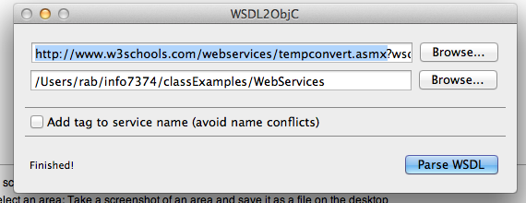

Slide 72
#import <Foundation/Foundation.h>
#import "USAdditions.h"
#import <libxml/tree.h>
#import "USGlobals.h"
@class TempConvert_FahrenheitToCelsius;
@class TempConvert_FahrenheitToCelsiusResponse;
@class TempConvert_CelsiusToFahrenheit;
@class TempConvert_CelsiusToFahrenheitResponse;
@interface TempConvert_FahrenheitToCelsius : NSObject {
/* elements */
NSString * Fahrenheit;
/* attributes */
}
- (NSString *)nsPrefix;
- (xmlNodePtr)xmlNodeForDoc:(xmlDocPtr)doc elementName:(NSString *)elName elementNSPrefix:(NSString *)elNSPrefix;
- (void)addAttributesToNode:(xmlNodePtr)node;
- (void)addElementsToNode:(xmlNodePtr)node;
+ (TempConvert_FahrenheitToCelsius *)deserializeNode:(xmlNodePtr)cur;
- (void)deserializeAttributesFromNode:(xmlNodePtr)cur;
- (void)deserializeElementsFromNode:(xmlNodePtr)cur;
/* elements */
@property (retain) NSString * Fahrenheit;
/* attributes */
- (NSDictionary *)attributes;
@end
@interface TempConvert_FahrenheitToCelsiusResponse : NSObject {
/* elements */
NSString * FahrenheitToCelsiusResult;
/* attributes */
}
- (NSString *)nsPrefix;
- (xmlNodePtr)xmlNodeForDoc:(xmlDocPtr)doc elementName:(NSString *)elName elementNSPrefix:(NSString *)elNSPrefix;
- (void)addAttributesToNode:(xmlNodePtr)node;
- (void)addElementsToNode:(xmlNodePtr)node;
+ (TempConvert_FahrenheitToCelsiusResponse *)deserializeNode:(xmlNodePtr)cur;
- (void)deserializeAttributesFromNode:(xmlNodePtr)cur;
- (void)deserializeElementsFromNode:(xmlNodePtr)cur;
/* elements */
@property (retain) NSString * FahrenheitToCelsiusResult;
/* attributes */
- (NSDictionary *)attributes;
@end

Slide 73
#import “TempConvert.h”
//create a binding and associate it with our service endpoint
TempConvertSoapBinding* binding = [[TempConvert TempConvertSoapBinding]
initWithAddress:
@"http://www.w3schools.com/webservices/tempconvert.asmx"];
binding.logXMLInOut = YES;
// create a request, fill in the blanks
TempConvert_CelsiusToFahrenheit* parms = [[TempConvert_CelsiusToFahrenheit alloc] init];
parms.Celsius= @”50”;
// call the service.
[binding CelsiusToFahrenheitAsyncUsingParameters: parms delegate:self];
[parms release];
//Should implement the protocol
//@protocol TempConvertSoapBindingResponseDelegate <NSObject>
//(void) operation:(TempConvertSoapBindingOperation *)operation completedWithResponse:(TempConvertSoapBindingResponse *)response;
//Implementing the delegate method
#pragma mark -
#pragma mark TempConvertSoapBindingResponseDelegate methods
- (void) operation:( TempConvertSoapBindingOperation *)operation
completedWithResponse:
( TempConvertSoapBindingResponse *)response
{
//[NSThread sleepForTimeInterval:5.0];
// Read the result.
for (id obj in response.bodyParts)
{
if ([obj isKindOfClass:[TempConvert_CelsiusToFahrenheitResponse class]])
{
NSString *fahrenheit = (TempConvert_CelsiusToFahrenheitResponse *)
obj.CelsiusToFahrenheitResult;
}
}
//If synchronous request is desired:
TempConvertSoapBindingResponse *resp = [binding FahrenheitToCelsiusUsingParameters: parms];
for (id id in resp.bodyParts)
{
if ([id isKindOfClass:[ TempConvert_CelsiusToFahrenheitResponse class]])
{
NSString *fahrenheit = [mine CelsiusToFahrenheitResult];
}
}
}

Slide 74
RESTful web services
A RESTful web service (also called a RESTful web API) is a web service implemented using HTTP and the principles of REST.
A collection of resources, with four defined aspects:
  the base URI for the web service, such as http://example.com/resources/
  the Internet media type of the data supported by the web service. This is often XML but can be any other valid Internet media type providing that it is a valid hypertext standard.
  the operations supported by the web service using HTTP methods (e.g., GET, PUT, POST, or DELETE).
  The API must be hypertext driven.^{[12][13]}

Slide 75
JSON
JavaScript Object Notation
  A lightweight data-interchange format.
  http://www.json.org/
  An object is an unordered set of name/value pairs.
    An object begins with { (left brace) and ends with } (right brace).
    Each name is followed by : (colon) and the name/value pairs are separated by , (comma).
  An array is an ordered collection of values.
    An array begins with [ (left bracket) and ends with ] (right bracket).
    Values are separated by , (comma).

Slide 76
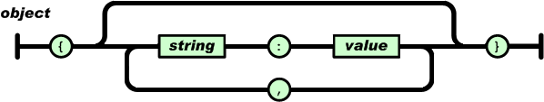
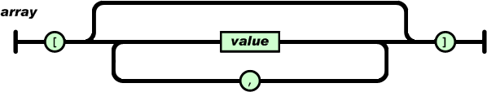
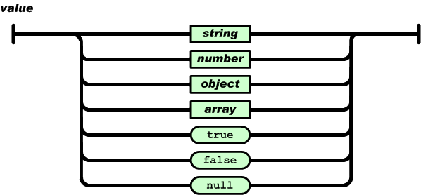

Slide 77
JSON Libraries
Native classes on latest SDK
Third party libraries such as:
BSJSONAdditions
  https://github.com/blakeseely/bsjsonadditions
For : { "myObject" : [ "value1", "value2" ] }
    BSJSONAdditions would create an NSDictionary with one entry, "myObject".
    The value for "myObject"'s entry would be an NSArray with 2 values, "value1" and "value2".

Slide 78
NSJSONSerialization ( iOS5)
To convert JSON to Foundation objects and convert Foundation objects to JSON.
An object that may be converted to JSON must have the following properties:
  The top level object is an NSArray or NSDictionary.
  All objects are instances of NSString, NSNumber, NSArray, NSDictionary, or NSNull.
  All dictionary keys are instances of NSString.
  Numbers are not NaN or infinity

Slide 79
Creating a JSON Object ( Objective-c)
+ JSONObjectWithData:options:error:
+ JSONObjectWithStream:options:error:
Creating JSON Data
+ dataWithJSONObject:options:error:
+ writeJSONObject:toStream:options:error:
+ isValidJSONObject:

Slide 80
Creating a JSON Object ( Swift )
class func jsonObject(with data: Data, options opt: JSONSerialization.ReadingOptions = []) throws -> Any
class func jsonObject(with stream: InputStream, options opt: JSONSerialization.ReadingOptions = []) throws -> Any
Creating JSON Data (Swift)
class func data(withJSONObject obj: Any, options opt: JSONSerialization.WritingOptions = []) throws -> Data
class func writeJSONObject(_ obj: Any, to stream: OutputStream, options opt: JSONSerialization.WritingOptions = [], error: NSErrorPointer) -> Int
class func isValidJSONObject(_ obj: Any) -> Bool

Slide 81
An object that may be converted to JSON must have the following properties:
The top level object is an NSArray or NSDictionary
All objects are instances of NSString, NSNumber, NSArray NSDictionary, or NSNull.
All dictionary keys are instances of NSString.
Numbers are not NaN or infinity.

Slide 82
func readJsonFromFile() {
if let path = Bundle.main.path(forResource: "data", ofType: "json") {
if let data = NSData(contentsOfFile: path) as? Data {
do {
let dict = try JSONSerialization.jsonObject(with: data , options:[]) as! [String: AnyObject]
print(“Parsed Result: \(dict))
} catch let error as NSError {
print("\(error)")
}
}
}
}

Slide 83
JSONSerialization.ReadingOptions
kNilOptions
  Equivalent to 0
mutableContainers:
  The arrays and dictionaries created will be mutable. Good if you want to add things to the containers after parsing it.
mutableLeaves:
  The leaves (i.e. the values inside the arrays and dictionaries) will be mutable. Good if you want to modify the strings read in, etc.
allowFragments:
  Parses out the top-level objects that are not arrays or dictionaries.

Slide 84
JSONSerialization.WritingOptions
static var prettyPrinted:
  For most compact possible JSON representation
  uses white space and indentation to make the output more readable
static var sortedKeys:
  sorts keys in lexicographic order
init(rawValue: UInt)
  Creates a set of JSON formatting options from an integer that represents those options

Slide 85
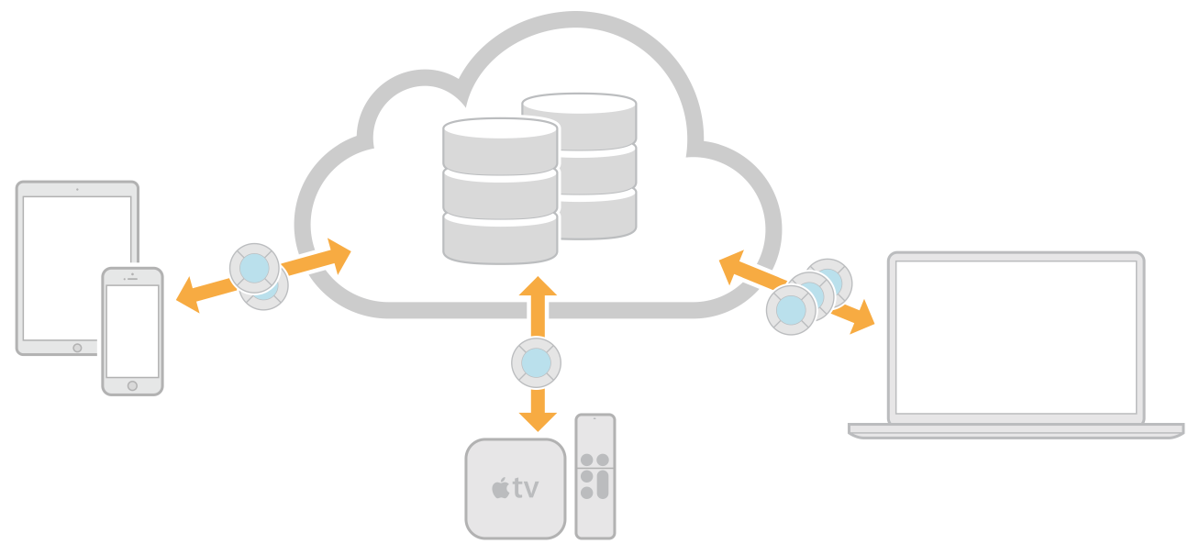
CloudKit
- CloudKit is an app service available only to apps distributed through the store.
- CloudKit app stores structured app and user data in iCloud.
Using CloudKit, instances of your app—launched by different users on different devices—have access to the records stored in the app’s database.
- Use CloudKit if you have model objects that you want to persist and share between multiple apps running on multiple devices.
These model objects are stored as records in the database and can be provided by you or authored by the user.

Slide 86
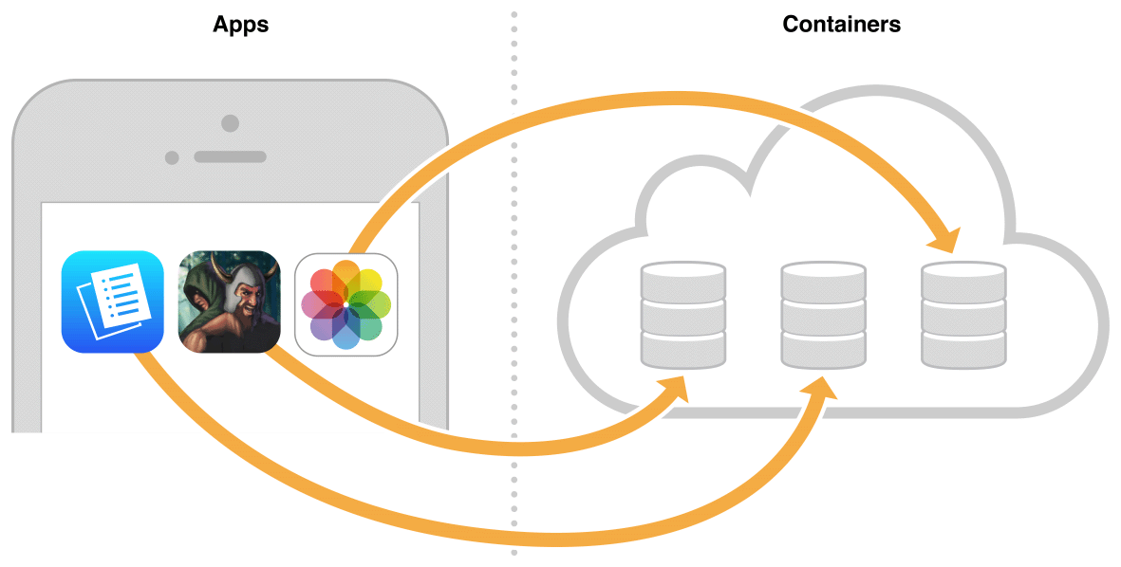
A container represents the app’s iCloud storage
Each container is divided into public and private databases

Slide 87
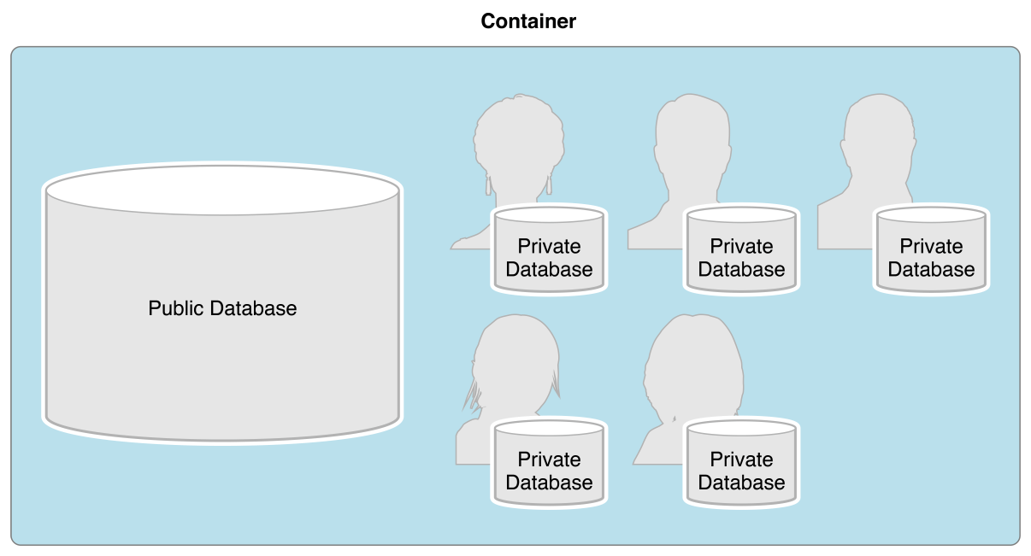
Some of the key features of CloudKit include:
up to 1 PB of asset storage (images, audio files, etc.)
up to 10 TB of database storage (strings, numbers, arrays, etc.)
iCloud user authentication
notifications
The public database is for storing user and app data that is shared between all instances of the app
By default, all users can read the public database, but they need to enter iCloud credentials to write to the public database
There is a private database for each user of your app,
The app only has access to the private database of the current user.
The user has to enter iCloud credentials for the app to read and write to the private database.

Slide 88
Possible field types, as they appear in CloudKit Dashboard, and their equivalent CloudKit framework classes
Field Type Class Description
Asset CKAsset A large file that is associated with a record but stored separately
Bytes NSData A wrapper for byte buffers that is stored with the record
Date/Time NSDate A single point in time
Double NSNumber A double
Int(64) NSNumber An integer
Location CLLocation A geographical coordinate and altitude
Reference CKReference A relationship from one object to another
String NSString An immutable text string
List NSArray Arrays of any of the above field types

Slide 89
To create a record in code
1- Create a record ID specifying a unique record name.
let artworkRecordID = CKRecordID(recordName: "115")
2- Create a record object.
let artworkRecord = CKRecord(recordType: "Artwork", recordID: artworkRecordID)
3- Set the record’s fields.
artworkRecord["title"] = "MacKerricher State Park" as NSString
artworkRecord["artist"] = "Mei Chen" as NSString
artworkRecord["address"] = "Fort Bragg, CA" as NSString

Slide 90
1- To save a recordGet the database in your app’s default container.
To get the public database:
let myContainer = CKContainer.default()
let publicDatabase = myContainer.publicCloudDatabase
To get the private database:
let myContainer = CKContainer.default()
let privateDatabase = myContainer.privateDatabase
To get a custom container:
let myContainer = CKContainer(identifier: "iCloud.com.example.ajohnson.GalleryShared")

Slide 91
2- Save the record.[publicDatabase
publicDatabase.save(artworkRecord) {
(record, error) in
if let error = error {
// Insert error handling
return
}
// Insert successfully saved record code
}

Slide 92
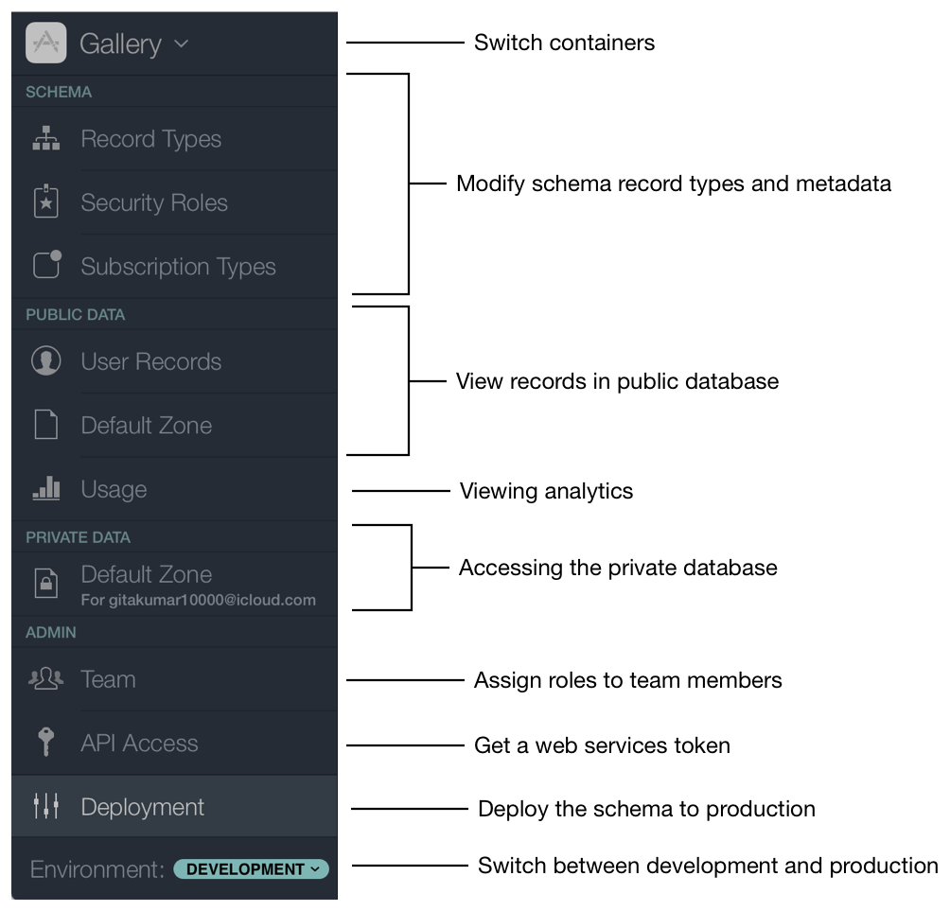
CloudKit Dashboard

Slide 93
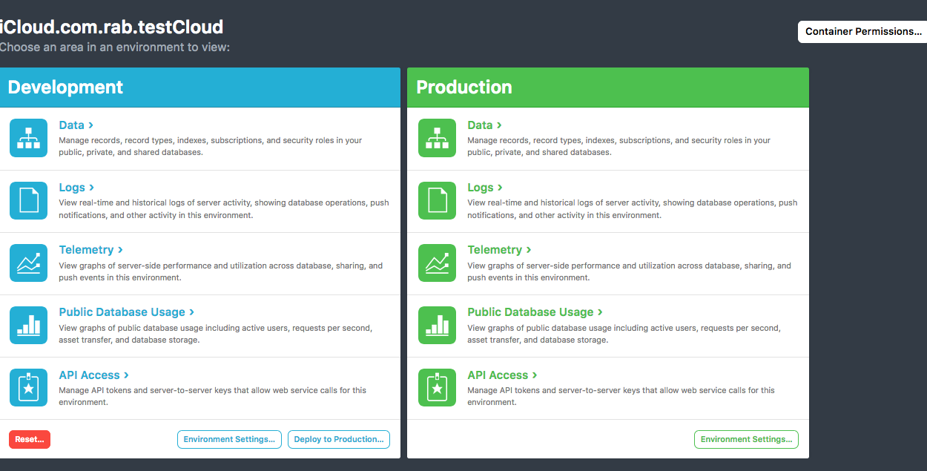
CloudKit Dashboard

Slide 94
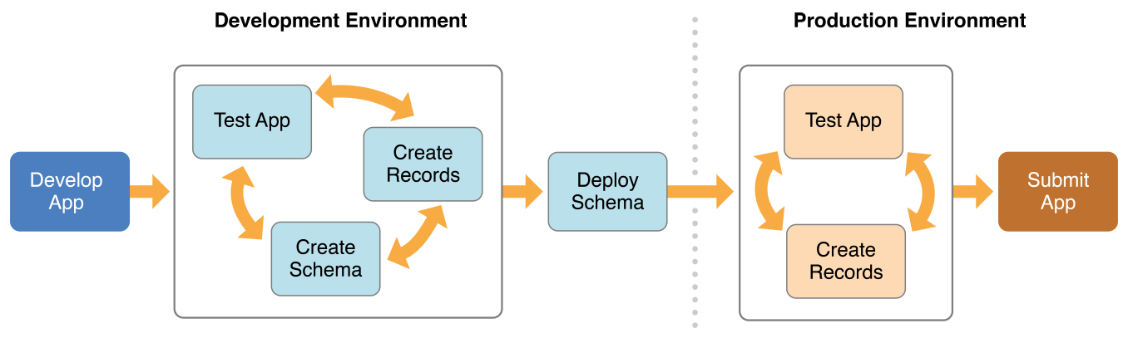
Development and Production Environments
- In the development environment, you can create, modify, and delete record types using CloudKit Dashboard.

Slide 95
Query for Records Using Predicates
CKDatabase *publicDatabase = [[CKContainer defaultContainer] publicCloudDatabase];
NSPredicate *predicate = [NSPredicate predicateWithFormat:@"title = %@", @"Santa Cruz Mountains"];
CKQuery *query = [[CKQuery alloc] initWithRecordType:@"Artwork" predicate:predicate];
[publicDatabase performQuery:query inZoneWithID:nil completionHandler:^(NSArray *results, NSError *error) {
if (error) {
// Error handling for failed fetch from public database
}
else {
// Display the fetched records
}
}];
// results is an array of CKRecord

Slide 96
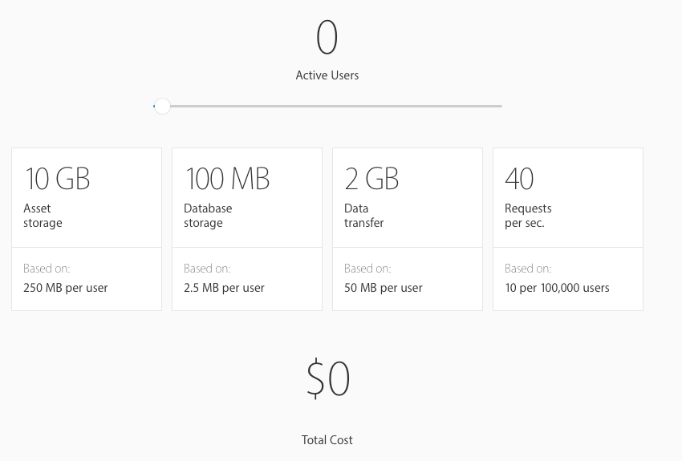

Slide 97
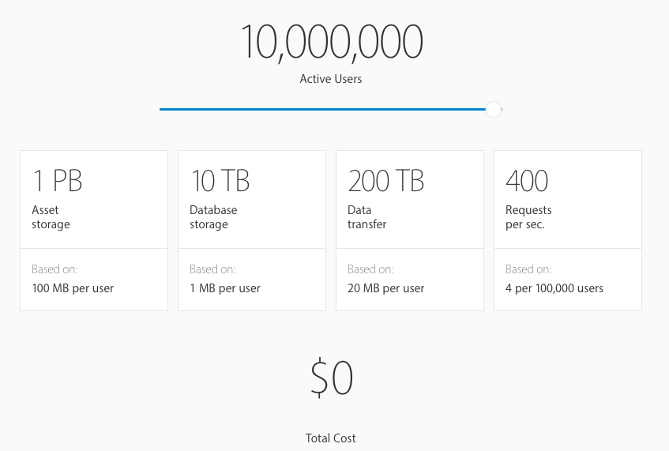
The amount of public storage and data transfer allocated to your apps will grow with every new active user
- All for free with very high limits.

Slide 98
FireBase
A cloud-hosted NoSQL database.
Data is stored as JSON, synced across connected devices in milliseconds
Available offline.
Intuitive and easy-to-use API.
Built on Google infrastructure and scales automatically, for even the largest apps.
Provides functionalities like analytics, databases, messaging and crash reporting
API for Android, iOS, C++, web. Unity
Authentication with Facebook, Google, Twitter, Github, or email

Slide 99
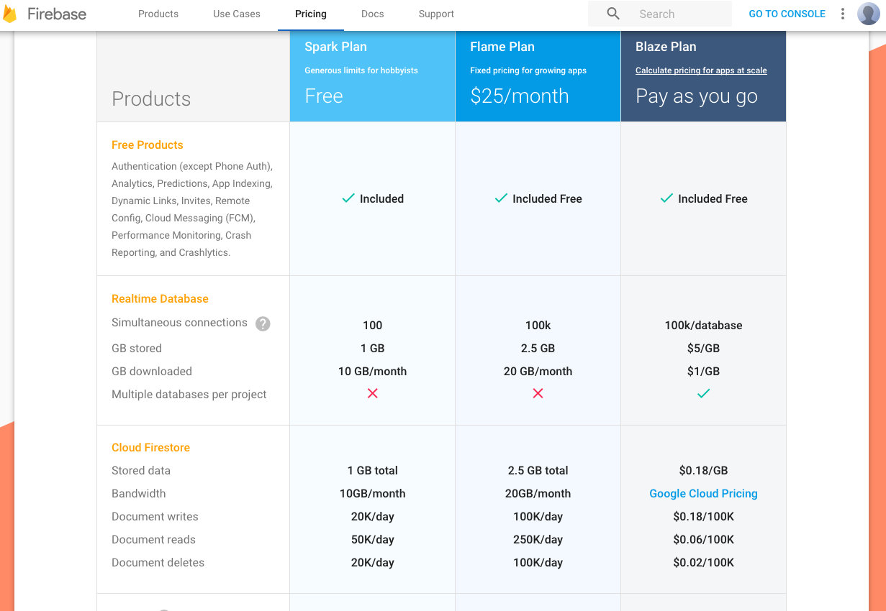

Slide 100
Import FireBase
//Configuration
// Use Firebase library to configure APIs
FirebaseApp.configure()
//create a reference to the database
var ref: DatabaseReference!
ref = Database.database().reference()
//add to database
self.ref.child("users").child(user.uid).setValue(["username": username])
//delete
self.ref.child("users").child(user.uid).removeValue()
//retrieve data
refHandle = postRef.observe(DataEventType.value, with: { (snapshot) in
let postDict = snapshot.value as? [String : AnyObject] ?? [:]
// ...
})

Slide 101
Other Backend systems
Parse Server
  Open source server released by Parse/Facebook to replicate functionality of Parse
AWS Mobile Hub (DynamoDB, Lambda, API Gateway, Cognito)
  Integrated console that helps create, build, test, and monitor mobile apps that leverage AWS services
  Use (Java, Python, or Node.js)

Slide 102
